Slide 1
Prerequisites
JAVA
OOPs concepts
Serialization
Data Structures (Hash Map, Lists)
FILE I/O
UNIX Commands (mv, cp, ls etc, mkdir, ps, vi)

Slide 2
What is Big Data?
Big data is an all-encompassing term for any collection of data sets so large and complex that it becomes difficult to process them using traditional data processing applications.
Extremely large data sets that may be analyzed computationally to reveal patterns, trends, and associations, especially relating to human behavior and interactions.

Slide 3

Characteristics of Big Data

Slide 4

Big Data Analytics
Big data analytics is the process of examining large data sets containing a variety of data types -- i.e., big data -- to uncover hidden patterns, unknown correlations, market trends, customer preferences and other useful business information.

Slide 5
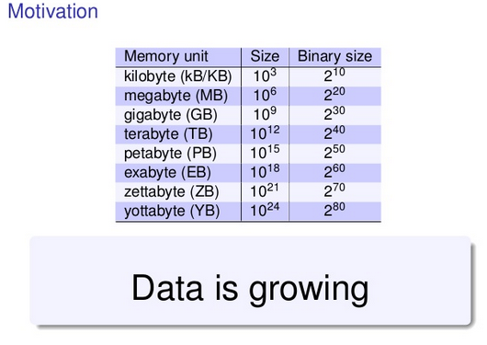
Measurement units

Slide 6

Challenges of Big Data
The challenges include analysis, capture, search, sharing, storage, transfer, visualization, and privacy violations.

Slide 7

Why is Big Data Important

Slide 8

The World of Big Data

Slide 9

Main Source of Big Data

Slide 10
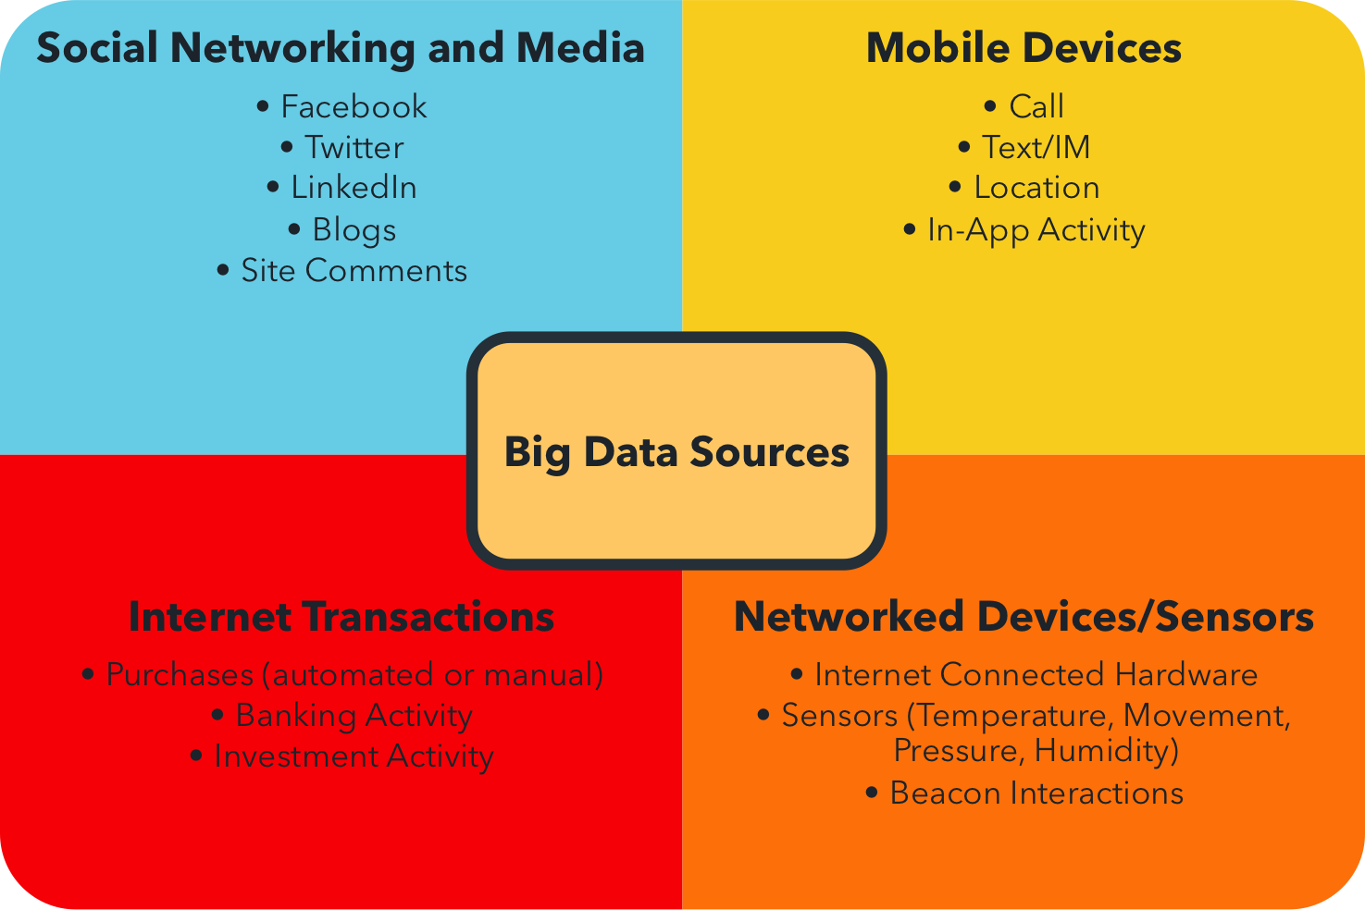
Key Sources

Slide 11
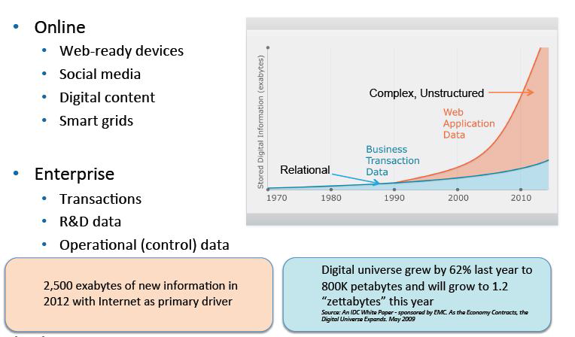
Explosion of Data

Slide 12


Slide 13



Slide 14

Applications

Slide 15


Slide 16
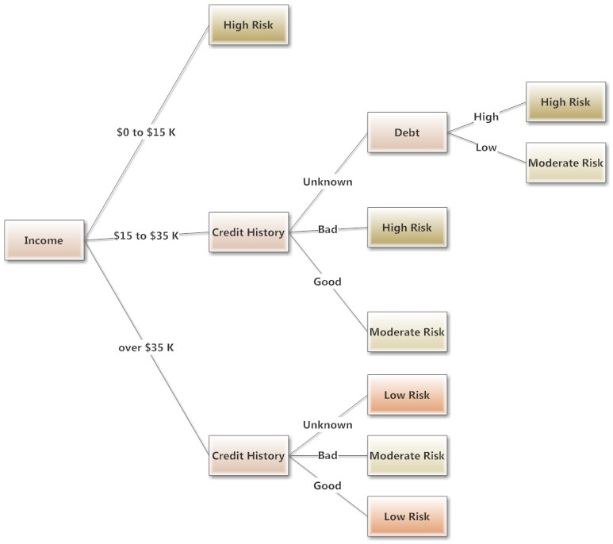
1
risk analysis and fraud detection

Slide 17





global investment bank
trade risk
search &
legal discovery
Trading
Data
ingest data
Customer
Data
intraday analysis
& historical analysis
(production reports +
exploratory risk modeling)

Slide 18
brand and sentiment analysis
2
the internet generates a lot of chatter about brands
understanding what’s said is key to protecting brand value
facebook & twitter generate a flood of data for large brands
capturing and processing direct feedback
better engagement and alerting via sentiment analysis
integration with other customer service systems
hadoop handles the diverse data types and processing
sources of data changing and semantics continuously evolving
sophistication of algorithms is iteratively improving

Slide 19



large media conglomerate
search &
application
Social
Media
ingest data
News, Blogs, etc.
Traditional
Media
real-time sentiment,
influence, gender,
topic extraction, etc.
trend analysis

Slide 20

3
customer insights/behavior

Slide 21

#5usecases
customer segmentation
customer insight
reports
Demographics,
Geography,
Web Data, etc.
ingest data
Point Of Sale
Purchase Data
shopping pattern
recognition

Slide 22
4
targeted marketing and personalization

Slide 23

#5usecases
major apparel brand
targeted discounts
pre-defined
web content
and deals
Clickstream
Data from Online
Storefront
ingest data
behavioral
cluster analysis
Notes:
Best explained by describing other use-cases like the GAP. Copying Flip and Tim, so they can benefit from the use-case....
When we stood up a Horton-works cluster at PARC for the GAP, we architected a system whereby we could combine real-time (Esper) with batch (Hortonworks) to essentially make GAP.com become both "interactive and intelligent".
This was done by analyzing click-stream log data in real-time to determine your behavior and based on what you were doing at that very instant, we served up personalized content to each individual user.....influencing them in real-time.
So based on your current activity (you interacted with the website), we acted to customize your experience, intelligently.
Where Hadoop came in was to build the "population-based behavioral" clusters, which allowed us to pre-define which content to serve up for you if and when you followed a certain real-time sequence.
For example, click-stream analysis in Hadoop determined that when a large, statistically significant group did the following:
Homepage
Jeans section
Skinny jeans
Long-sleeve shirts
They were 90% likely to buy both jeans and shirts together.
Whereas, if you did the following:
Homepage
Long-sleeve shirts
Jeans
Skinny jeans
You only bought the shirt! UNLESS there was at least a 20% discount associated with it.
Two different clusters determined through complex Hadoop analysis over a long period of time.
So....when you surf the web in real-time on the site, you see the following interactive behavior happen:
Cluster 1: Homepage->Jeans->Skinny -> Recommendation to go to Long-sleeve shirts -> Long-sleeve shirts -> Purchase with NO Discount
Cluster 2: Homepage->Long-sleeve shirts -> Recommendation to go to Jeans -> Skinny jeans -> 20% discount offered in real-time -> Purchase
This is an interactive and intelligent web and e-commerce application which is 100% data-driven.

Slide 24

God for Business : Customer

Slide 25


Slide 26
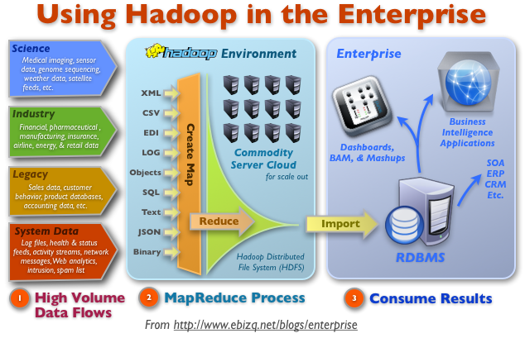
Using Hadoop in Enterprise

Slide 27
Hadoop Technology stack
Hadoop Core
Hadoop Projects
Hadoop Incubator
Stack Implemtation

Slide 28
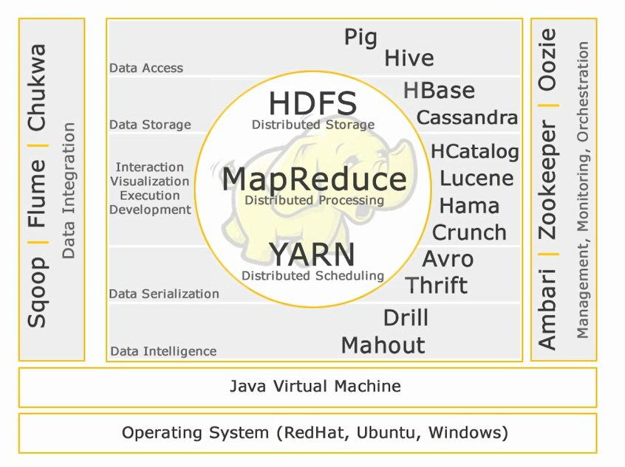
Hadoop Technology stack

Slide 29
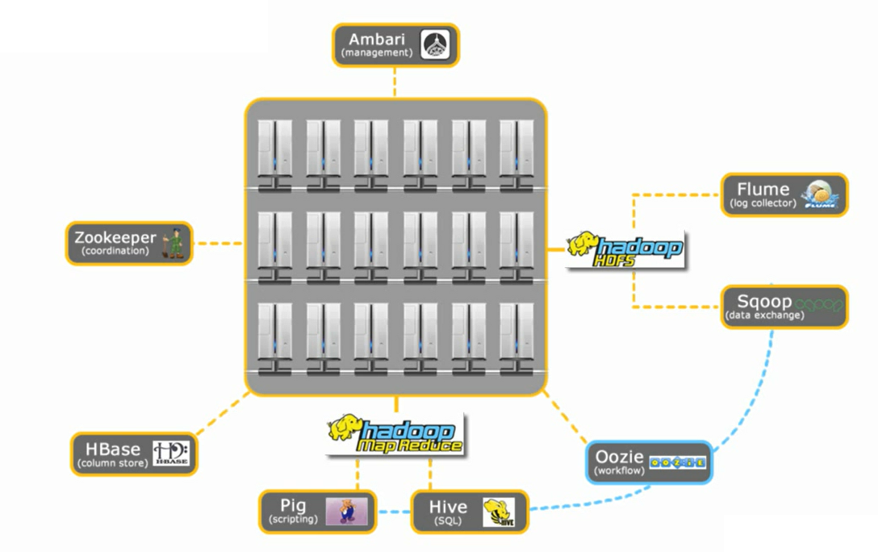
Hadoop technology stack

Slide 30

BigData ≈
Started by Google White paper about Map-Reduce
Open Source
Apache Software foundation
Current version 2.2.0
Second Generation
Set of tools – Core Map-Reduce
http://hadoop.apache.org/#What+Is+Apache+Hadoop%3F
Notes:
BigData term associated with Hadoop

Slide 31
Map-Reduce paradigm
HDFS – Hadoop Distributed File System
YARN – Yet another resource negotiator – promotes cluster to non-MapReduce computational models

Slide 32
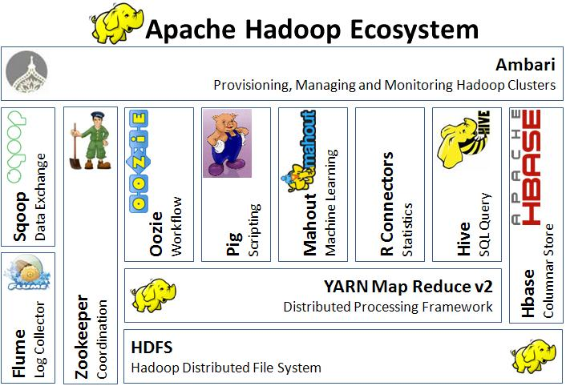
HADOOP Eco system

Slide 33

PIG
Scripting language for Map-Reduce
Procedural language
Typical use cases:
standard extract-transform-load (ETL) data pipelines
research on raw data
iterative processing of data

Slide 34

HIVE
SQL-like syntax
Data warehouse – ad-hoc queries
Declarative language
On top of Map-Reduce

Slide 35
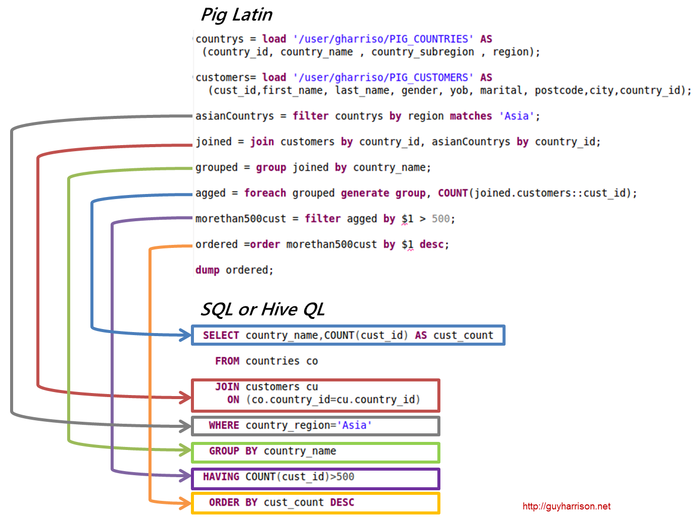
PIG x HIVE

Slide 36

HBase
Real-time access to data
non-relational (NoSQL) database
Columnar database
Run on HDFS
Fault tolerant, Flexible, Highly Available

Slide 37

Apache Flume
Streaming data into hadoop
Collecting, Aggregating
Guarantee data delivery
Scale horizontally

Slide 38
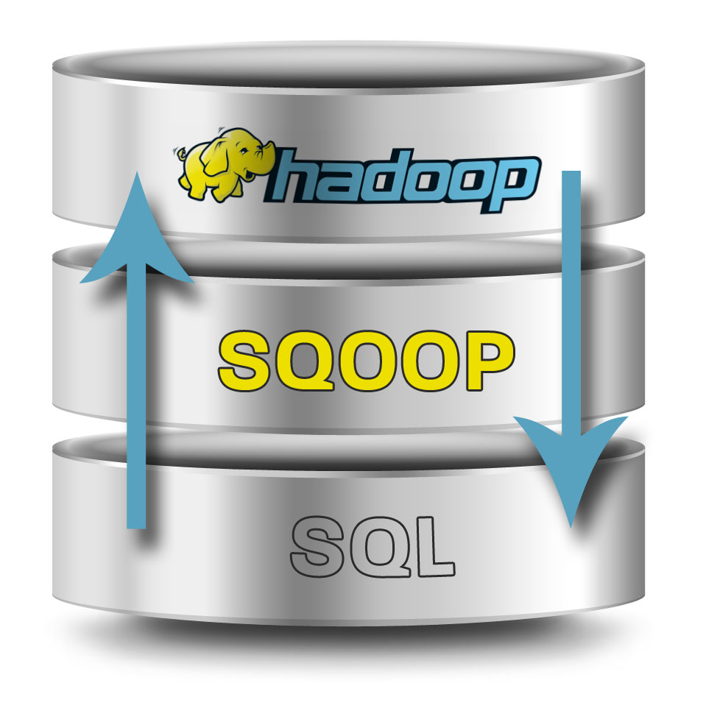
Apache Sqoop
Move data between Hadoop and structured datastores – relational databases
Import into HDFS, Hbase or Hive

Slide 39

Apache ZooKeeper
Distributed configuration service
Synchronization service
Naming registry
Reliable, Simple, Ordered

Slide 40

Apache OoZiE
Workflow engine
DAG = Directed Acyclic Graph
Integrates with:
MapReduce
PIG
Hive
Sqoop

Slide 41
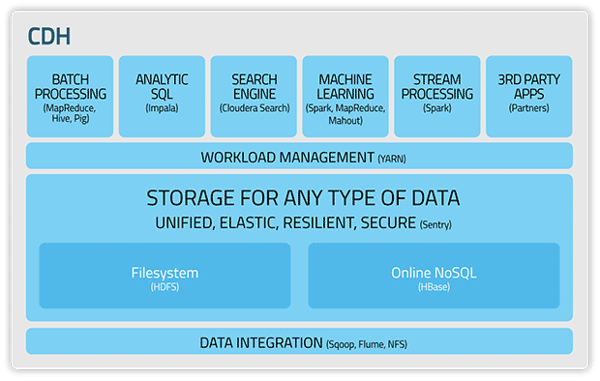
Cloudera Ecosystem

Slide 42



Distributions

Slide 43
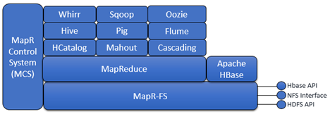
MapR Ecosystem

Slide 44
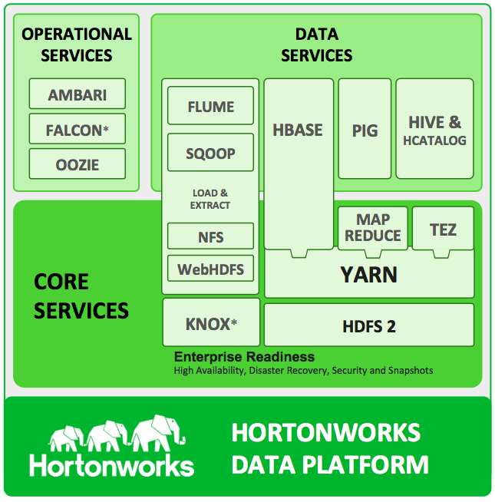
Ecosystem

Slide 45
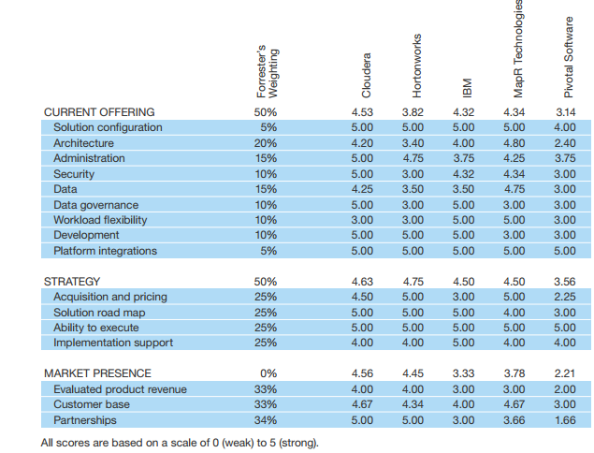

Comparison of Enterprise distributions
https://www.cloudera.com/content/dam/www/static/documents/analyst-reports/forrester-wave-big-data-hadoop-distributions.pdf

Slide 46
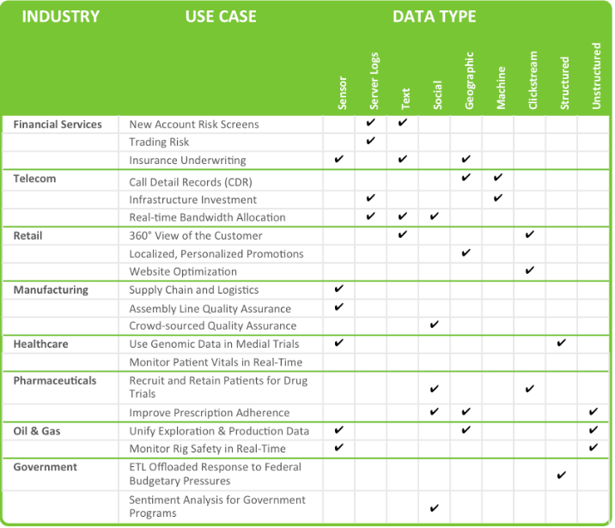
Hortonworks Big Data Use Cases

Slide 47
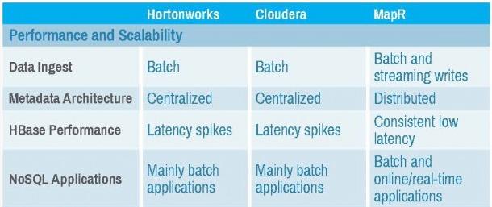
Performance and scalability

Slide 48
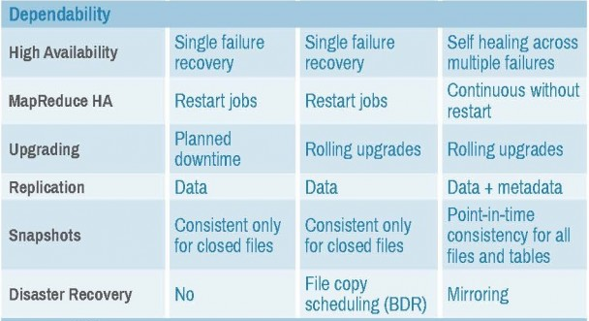
Dependability

Slide 49
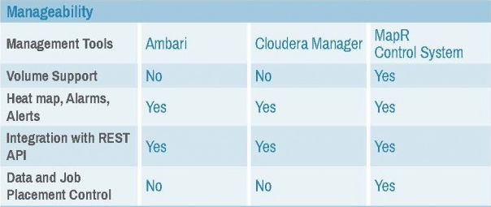
Manageability

Slide 50
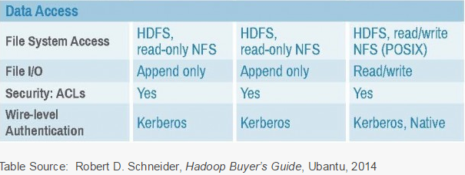
Data Access

Slide 51
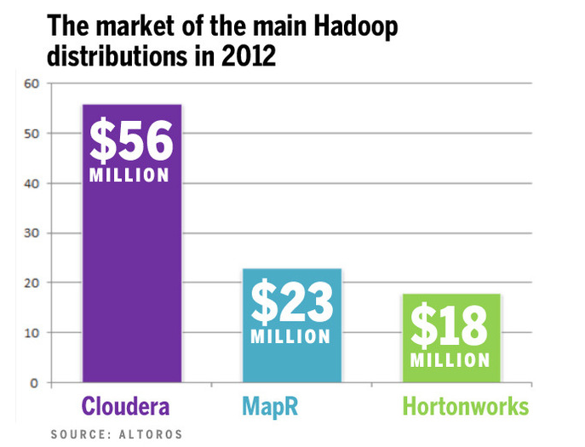

Slide 52
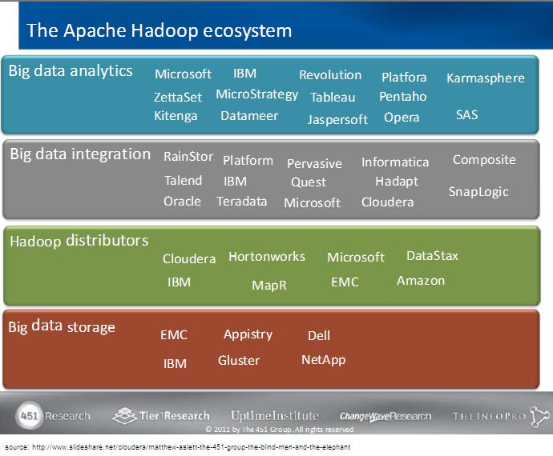
Different Players in Hadoop

Slide 53
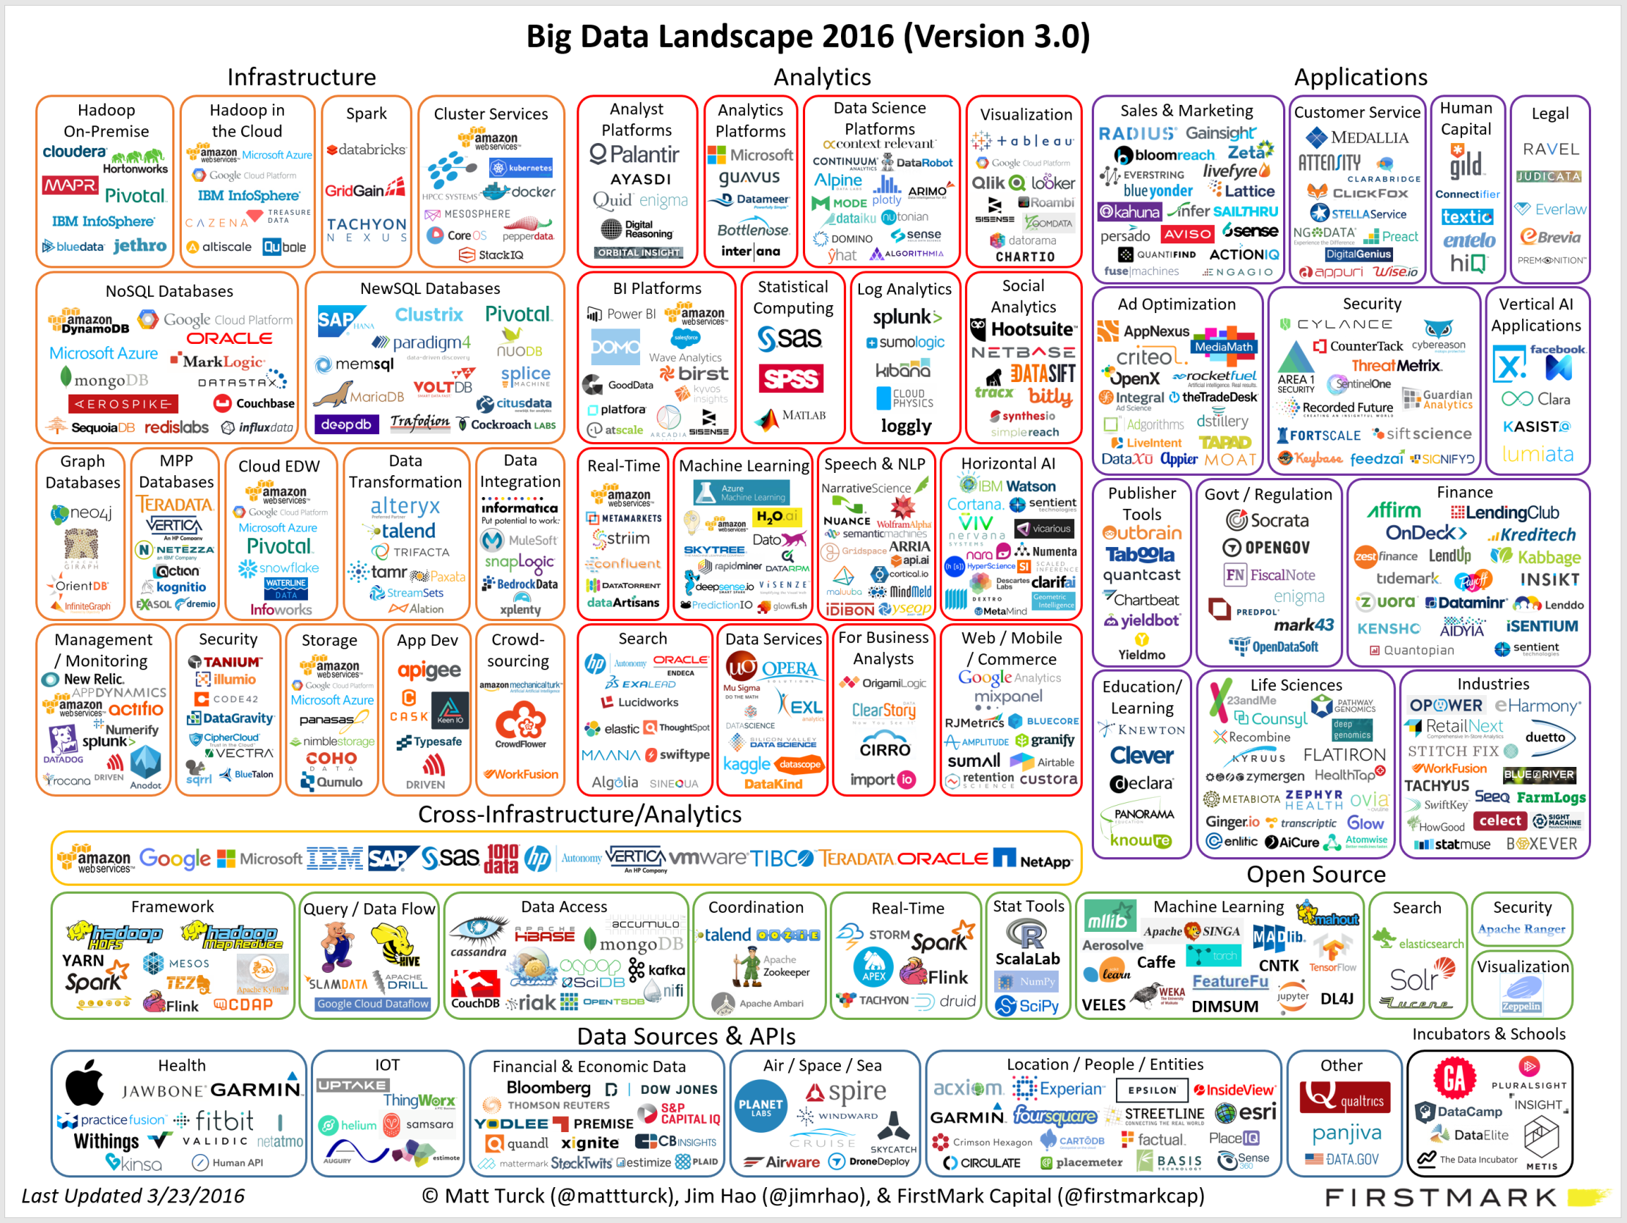

Slide 54
Agenda for Today’s Session
Significance of HDFS in Hadoop
HDFS Features
Daemons of Hadoop and functionalities
Data Storage in HDFS
Accessing HDFS
Data Flow
Anatomy of a File Read
Anatomy of a File Write
Hadoop Archives
Copyright 2013-14

Slide 55
When dataset out grows the storage of single capacity…

Slide 56
Introduction HDFS
The Hadoop Distributed File System (HDFS) is a distributed file system designed to run on commodity hardware.
HDFS is highly fault-tolerant and is designed to be deployed on low-cost hardware.
HDFS provides high throughput access to application data and is suitable for applications that have large data sets.

Slide 57
Assumptions and Goals
Hardware failure
streaming Data Access
large Data Sets
simple Coherency Model
Moving Computation is Cheaper than Moving Data
Portability Across Heterogeneous Hardware and Software Platforms

Slide 58
Hardware failure
Hardware failure is the norm rather than the exception.
An HDFS instance may consist of hundreds or thousands of server machines, each storing part of the file system’s data.
Detection of faults and quick, automatic recovery from them is a core architectural goal of HDFS.

Slide 59
Streaming Data Access
Applications that run on HDFS need streaming access to their data sets.
HDFS is designed more for batch processing rather than interactive use by users.

Slide 60
Large Data Sets
Applications that run on HDFS have large data sets.
A typical file in HDFS is gigabytes to terabytes in size. Thus, HDFS is tuned to support large files.
It should provide high aggregate data bandwidth and scale to hundreds of nodes in a single cluster.
It should support tens of millions of files in a single instance.

Slide 61
Simple Coherency Model
HDFS applications need a write-once-read-many access model for files.
A file once created, written, and closed need not be changed.
This assumption simplifies data coherency issues and enables high throughput data access.’
There is a plan to support appending-writes to files in the future.

Slide 62
“Moving Computation is Cheaper than Moving Data”
A computation requested by an application is much more efficient if it is executed near the data it operates on. This is especially true when the size of the data set is huge.
HDFS provides interfaces for applications to move themselves closer to where the data is located.
This minimizes network congestion and increases the overall throughput of the system.

Slide 63
Portability Across Heterogeneous Hardware and Software Platforms
HDFS has been designed to be easily portable from one platform to another.
This facilitates widespread adoption of HDFS as a platform of choice for a large set of applications.

Slide 64


Slide 65
NameNode and DataNodes
HDFS has a master/slave architecture.
An HDFS cluster consists of a single NameNode, a master server that manages the file system namespace and regulates access to files by clients.
In addition, there are a number of DataNodes, usually one per node in the cluster, which manage storage attached to the nodes that they run on.

Slide 66
Name Nodes and data nodes
HDFS exposes a file system namespace and allows user data to be stored in files.
Internally, a file is split into one or more blocks and these blocks are stored in a set of DataNodes.
NameNode:
The NameNode executes file system namespace operations like opening, closing, and renaming files and directories.
It also determines the mapping of blocks to DataNodes.
DataNodes:
The DataNodes are responsible for serving read and write requests from the file system’s clients.
The DataNodes also perform block creation, deletion, and replication upon instruction from the NameNode.

Slide 67
Key points
The NameNode and DataNode are pieces of software designed to run on commodity machines.
HDFS is built using the Java language; any machine that supports Java can run the NameNode or the DataNode software.
The existence of a single NameNode in a cluster greatly simplifies the architecture of the system.
The NameNode is the arbitrator and repository for all HDFS metadata.
The system is designed in such a way that user data never flows through the NameNode.

Slide 68
File system Name Space
HDFS supports a traditional hierarchical file organization.
A user or an application can create directories and store files inside these directories.
The file system namespace hierarchy is similar to most other existing file systems; one can create and remove files, move a file from one directory to another, or rename a file.
The NameNode maintains the file system namespace. Any change to the file system namespace or its properties is recorded by the NameNode.
An application can specify the number of replicas of a file that should be maintained by HDFS. The number of copies of a file is called the replication factor of that file. This information is stored by the NameNode.

Slide 69
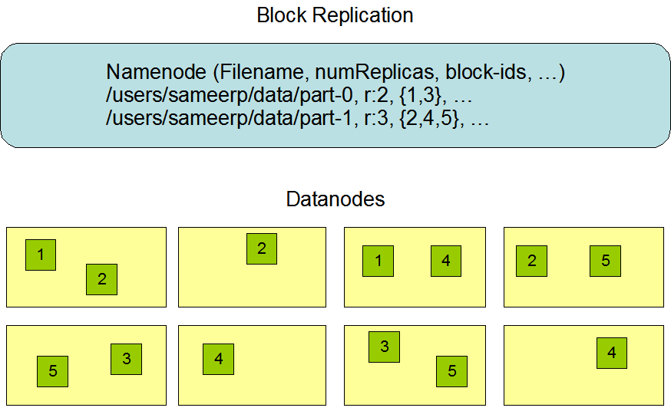
Data Replication

Slide 70
Data Replication
HDFS is designed to reliably store very large files across machines in a large cluster. It stores each file as a sequence of blocks; all blocks in a file except the last block are the same size.
The blocks of a file are replicated for fault tolerance. The block size and replication factor are configurable per file.
The NameNode makes all decisions regarding replication of blocks.
It periodically receives a Heartbeat and a Blockreport from each of the DataNodes in the cluster.
Receipt of a Heartbeat implies that the DataNode is functioning properly.
A Blockreport contains a list of all blocks on a DataNode.
Replica Placement: The First Baby Steps
Replica Selection
Safemode

Slide 71
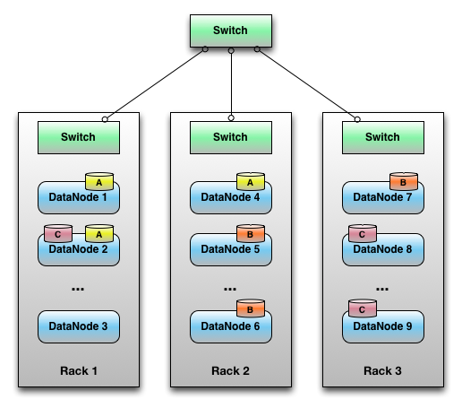
Data Replication : Replica Replacement
The placement of replicas is critical to HDFS reliability and performance.
The NameNode determines the rack id each DataNode belongs to via the process outlined in Hadoop Rack Awareness.

Slide 72
Replica Selection
To minimize global bandwidth consumption and read latency, HDFS tries to satisfy a read request from a replica that is closest to the reader.
If there exists a replica on the same rack as the reader node, then that replica is preferred to satisfy the read request.
If an HDFS cluster spans multiple data centers, then a replica that is resident in the local data center is preferred over any remote replica.

Slide 73
Safemode
On startup, the NameNode enters a special state called Safemode.
NameNode receives HeartBeat and Blockreport messages from DataNode.
A Blockreport contains the list of data blocks that a DataNode is hosting.
A block is considered safely replicated when the minimum number of replicas of that data block has checked in with the NameNode.
After a configurable percentage of safely replicated data blocks checks in with the NameNode (plus an additional 30 seconds), the NameNode exits the Safemode state.
It then determines the list of data blocks (if any) that still have fewer than the specified number of replicas. The NameNode then replicates these blocks to other DataNodes.

Slide 74
Blocks
Default is 64 MB, editable to 128 MB.
Why is block size so large?
lets do a simple calculation
Blocks abstraction

Slide 75
BLOCK caching
Frequently accessed files?
Lookup files?
Automation of programs?

Slide 76
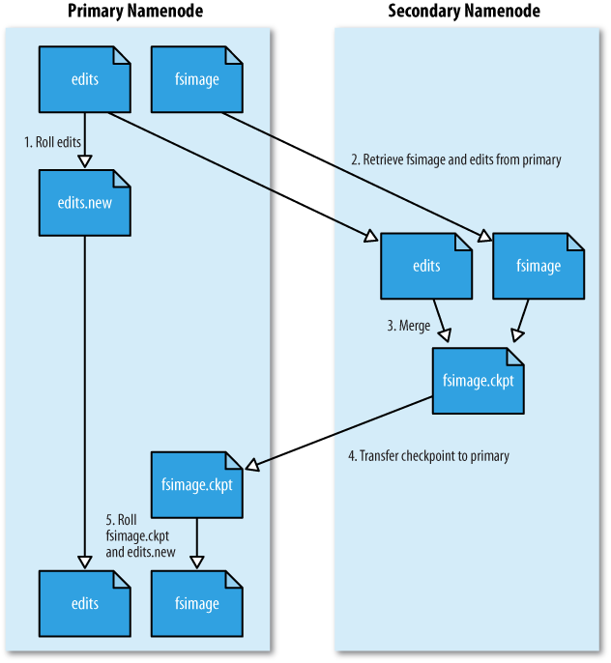
The Persistence of File System Metadata : Secondary Name Node

Slide 77
Key points
The NameNode keeps an image of the entire file system namespace and file Blockmap in memory.
The FsImage is stored as a file in the NameNode’s local file system too.
When the NameNode starts up, it reads the FsImage and EditLog from disk, applies all the transactions from the EditLog to the in-memory representation of the FsImage, and flushes out this new version into a new FsImage on disk.
It can then truncate the old EditLog because its transactions have been applied to the persistent FsImage. This process is called a checkpoint.
When a DataNode starts up, it scans through its local file system, generates a list of all HDFS data blocks that correspond to each of these local files and sends this report to the NameNode: this is the Blockreport.

Slide 78
The Communication Protocols
All HDFS communication protocols are layered on top of the TCP/IP protocol. A client establishes a connection to a configurable TCP port on the NameNode machine. It talks the ClientProtocol with the NameNode.
The DataNodes talk to the NameNode using the DataNode Protocol. A Remote Procedure Call (RPC) abstraction wraps both the Client Protocol and the DataNode Protocol.
By design, the NameNode never initiates any RPCs. Instead, it only responds to RPC requests issued by DataNodes or clients.

Slide 79
Robustness
Data Disk Failure, Heartbeats and Re-Replication
Cluster Rebalancing
Data Integrity
Metadata Disk Failure
Snapshots

Slide 80
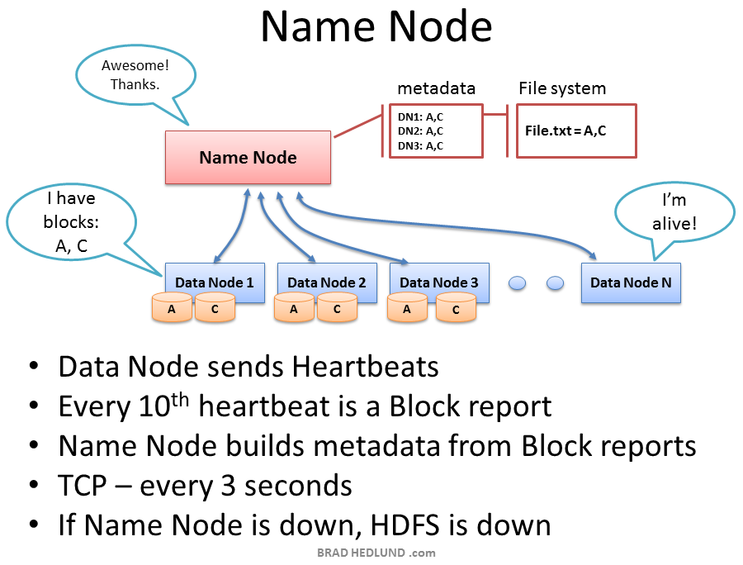
Data Disk Failure, Heartbeats and Re-Replication

Slide 81
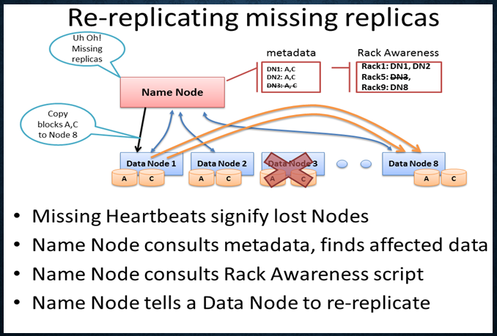
Data Disk Failure, Heartbeats and Re-Replication

Slide 82
Cluster Rebalancing
The HDFS architecture is compatible with data rebalancing schemes. A scheme might automatically move data from one DataNode to another if the free space on a DataNode falls below a certain threshold.
In the event of a sudden high demand for a particular file, a scheme might dynamically create additional replicas and rebalance other data in the cluster.
These types of data rebalancing schemes are not yet implemented.

Slide 83
Data Integrity
It is possible that a block of data fetched from a DataNode arrives corrupted.
This corruption can occur because of faults in a storage device, network faults, or buggy software.
The HDFS client software implements checksum checking on the contents of HDFS files.
When a client creates an HDFS file, it computes a checksum of each block of the file and stores these checksums in a separate hidden file in the same HDFS namespace.
When a client retrieves file contents it verifies that the data it received from each DataNode matches the checksum stored in the associated checksum file.
If not, then the client can opt to retrieve that block from another DataNode that has a replica of that block.

Slide 84
Metadata Disk Failure
The FsImage and the EditLog are central data structures of HDFS. A corruption of these files can cause the HDFS instance to be non-functional. For this reason, the NameNode can be configured to support maintaining multiple copies of the FsImage and EditLog.
Any update to either the FsImage or EditLog causes each of the FsImages and EditLogs to get updated synchronously.
This synchronous updating of multiple copies of the FsImage and EditLog may degrade the rate of namespace transactions per second that a NameNode can support.
However, this degradation is acceptable because even though HDFS applications are very data intensive in nature, they are not metadata intensive. When a NameNode restarts, it selects the latest consistent FsImage and EditLog to use.

Slide 85
Snapshots
Snapshots support storing a copy of data at a particular instant of time.
One usage of the snapshot feature may be to roll back a corrupted HDFS instance to a previously known good point in time.
HDFS does not currently support snapshots but will in a future release.

Slide 86
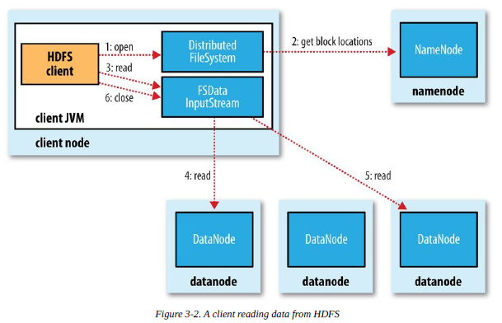
Anatomy of file read

Slide 87
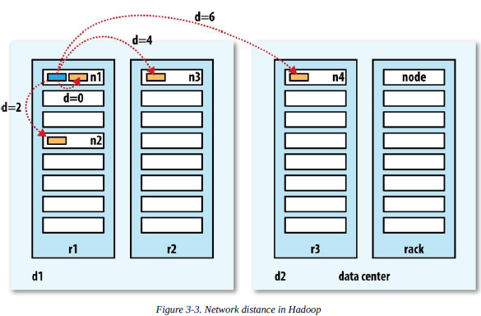
Network distance on hadoop

Slide 88
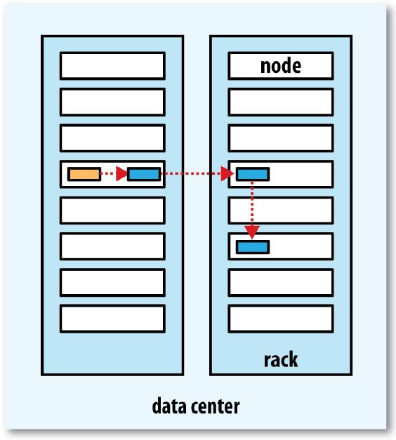
A typical replica pipeline

Slide 89
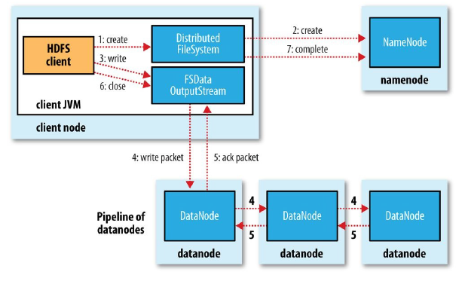
Anatomy of file write

Slide 90
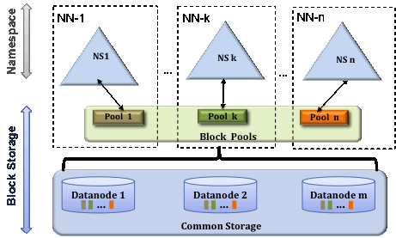
Multiple Namenodes/Namespaces
In order to scale the name service horizontally, federation uses multiple independent Namenodes/namespaces. The Namenodes are federated, that is, the Namenodes are independent and don’t require coordination with each other.
The datanodes are used as common storage for blocks by all the Namenodes. Each datanode registers with all the Namenodes in the cluster. Datanodes send periodic heartbeats and block reports and handles commands from the Namenodes.

Slide 91
Block Pool
A Block Pool is a set of blocks that belong to a single namespace.
Datanodes store blocks for all the block pools in the cluster. It is managed independently of other block pools.
This allows a namespace to generate Block IDs for new blocks without the need for coordination with the other namespaces.
The failure of a Namenode does not prevent the datanode from serving other Namenodes in the cluster.
A Namespace and its block pool together are called Namespace Volume.
It is a self-contained unit of management. When a Namenode/namespace is deleted, the corresponding block pool at the datanodes is deleted.
Each namespace volume is upgraded as a unit, during cluster upgrade.

Slide 92
ClusterID
A new identifier ClusterID is added to identify all the nodes in the cluster.
When a Namenode is formatted, this identifier is provided or auto generated.
This ID should be used for formatting the other Namenodes into the cluster.

Slide 93
Key Benefits
Namespace Scalability - HDFS cluster storage scales horizontally but the namespace does not. Large deployments or deployments using lot of small files benefit from scaling the namespace by adding more Namenodes to the cluster
Performance - File system operation throughput is limited by a single Namenode in the prior architecture. Adding more Namenodes to the cluster scales the file system read/write operations throughput.
Isolation - A single Namenode offers no isolation in multi user environment. An experimental application can overload the Namenode and slow down production critical applications. With multiple Namenodes, different categories of applications and users can be isolated to different namespaces.

Slide 94
Background
Prior to Hadoop 2.0.0, the NameNode was a single point of failure (SPOF) in an HDFS cluster. Each cluster had a single NameNode, and if that machine or process became unavailable, the cluster as a whole would be unavailable until the NameNode was either restarted or brought up on a separate machine.
This impacted the total availability of the HDFS cluster in two major ways:
In the case of an unplanned event such as a machine crash, the cluster would be unavailable until an operator restarted the NameNode.
Planned maintenance events such as software or hardware upgrades on the NameNode machine would result in windows of cluster downtime.
The HDFS High Availability feature addresses the above problems by providing the option of running two redundant NameNodes in the same cluster in an Active/Passive configuration with a hot standby. This allows a fast failover to a new NameNode in the case that a machine crashes, or a graceful administrator-initiated failover for the purpose of planned maintenance.

Slide 95
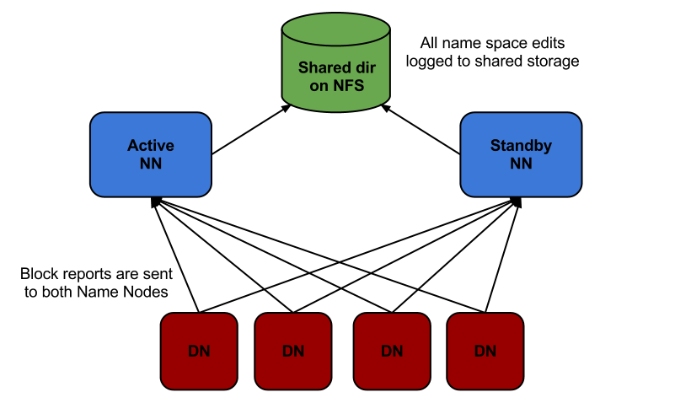
HDFS High Availability

Slide 96
Architecture
In a typical HA cluster, two separate machines are configured as NameNodes.
At any point in time, exactly one of the NameNodes is in an Active state, and the other is in a Standby state.
The Active NameNode is responsible for all client operations in the cluster, while the Standby is simply acting as a slave, maintaining enough state to provide a fast failover if necessary.

Slide 97
Architecture
In order for the Standby node to keep its state synchronized with the Active node, both nodes communicate with a group of separate daemons called "JournalNodes" (JNs).
When any namespace modification is performed by the Active node, it durably logs a record of the modification to a majority of these JNs.
The Standby node is capable of reading the edits from the JNs, and is constantly watching them for changes to the edit log.
As the Standby Node sees the edits, it applies them to its own namespace. In the event of a failover, the Standby will ensure that it has read all of the edits from the JounalNodes before promoting itself to the Active state.
This ensures that the namespace state is fully synchronized before a failover occurs.

Slide 98
Architecture
In order to provide a fast failover, it is also necessary that the Standby node have up-to-date information regarding the location of blocks in the cluster.
In order to achieve this, the DataNodes are configured with the location of both NameNodes, and send block location information and heartbeats to both.

Slide 99
Architecture
It is vital for the correct operation of an HA cluster that only one of the NameNodes be Active at a time.
Otherwise, the namespace state would quickly diverge between the two, risking data loss or other incorrect results.
In order to ensure this property and prevent the so-called "split-brain scenario," the JournalNodes will only ever allow a single NameNode to be a writer at a time.
During a failover, the NameNode which is to become active will simply take over the role of writing to the JournalNodes, which will effectively prevent the other NameNode from continuing in the Active state, allowing the new Active to safely proceed with failover.

Slide 100
How does it Run
HDFS files are not part of ordinary file system. "ls" command will not list the files in HDFS.
HADOOP runs as a separate process and in a different namespace isolated from normal FS on the OS.
HDFS files/blocks are stored in a particular directory controlled by Datanode. Files are stored with block Ids. You can't interact with them using normal Unix commands.
There are separate utilities similar to Unix that can be used to access the HDFS

Slide 101
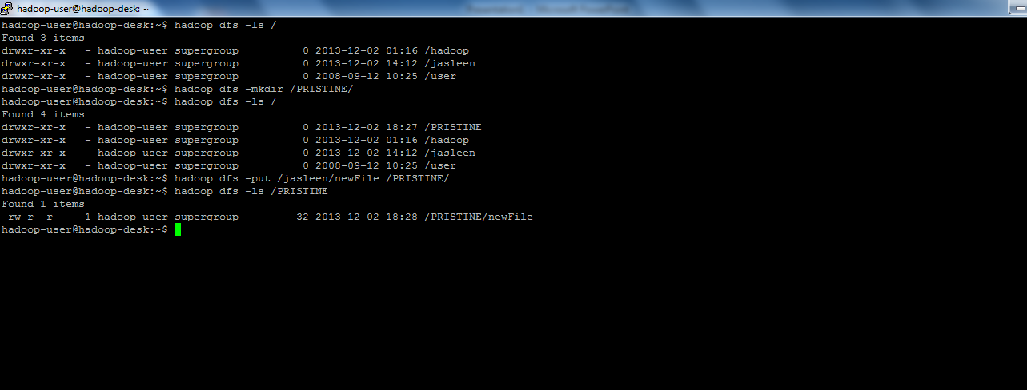
Listing files in hdfs

Slide 102
Environment Needed for HADOOP
The production and stable environment for HADOOP is Unix.
You can run HADOOP on windows as well, but again you would need Unix like system (e.g., cygwin) to run HADOOP processes. For this cygwin should be run as a service in windows OS and can be a problem if user doesn’t have admin rights
Since most people have Windows OS, we will run HADOOP on preconfigured VM (given by Yahoo/CDH)

Slide 103
Configuring and Setting up HDFS
Download vm player from http://www.vmware.com/support/download-player
HADOOP vm from cloudera can be downloaded from http://content.udacity-data.com/courses/ud617/Cloudera-Udacity-Training-VM-4.1.1.c.zip
HADOOP has introduced several versions the vm image present in the following link is 0.18 version of HADOOP http://developer.yahoo.com/hadoop/tutorial/module3.html
Download putty from http://www.putty.org/ and winscp http://winscp.net/eng/download.php

Slide 104
Steps
After VMplayer is successfully installed, extract Cloudera-Udacity-4.1 zip to a folder

Slide 105
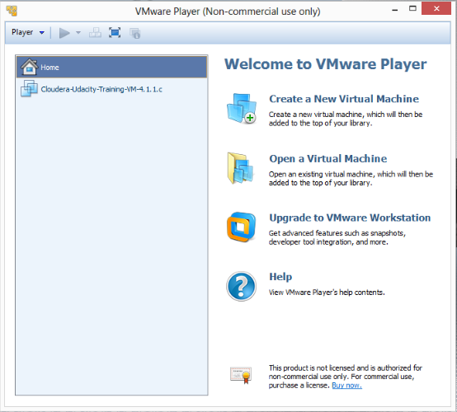
VMware Setup
Double click on VM player quick launcher, following screen will be opened

Slide 106
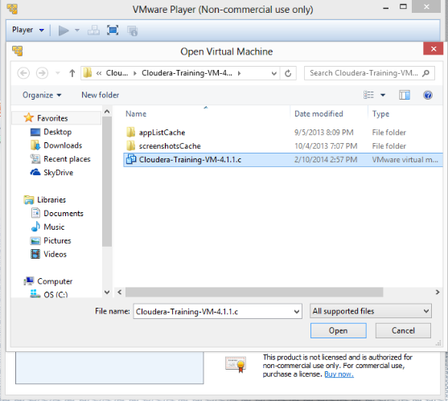
Cont.
Click on ‘Open a Virtual Machine’ and direct to extracted image folder.

Slide 107
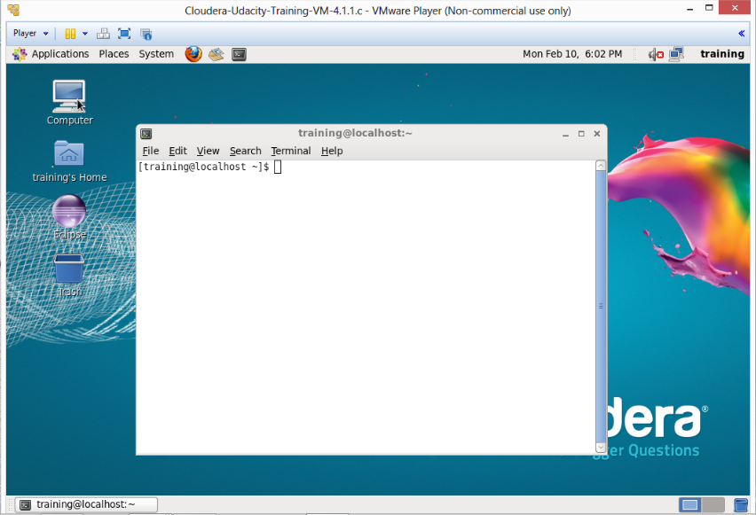
Cont.
After opening the image following information will be displayed in vm player

Slide 108
Cont.
This vm image is configured with 2 users root and training. The password of training user is training.
As soon as the vm is loaded correctly, an IP is assigned to it . In the screenshot attached the IP is 192.168.31.129.
The user training is sudo user of the system.
You can also connect to this vm using ssh.

Slide 109
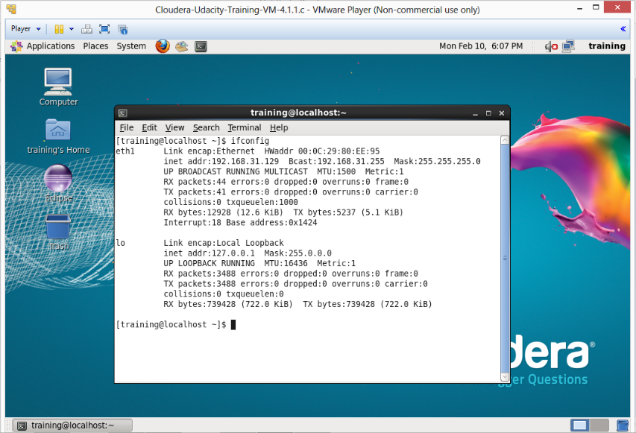
Cont.
The ip of vm can be found by typing ifconfig in terminal

Slide 110
Cont.
To use the vm either directly use vm or putty.
Whichever UI, student finds suitable can be used. Both are pointing to the same server.

Slide 111
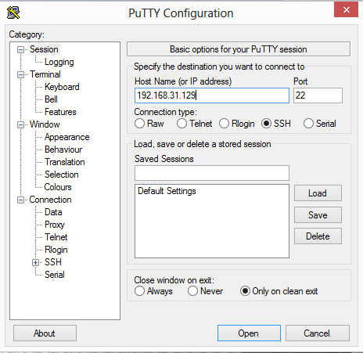
Cont.
Double click on putty.exe and enter the IP of vm

Slide 112
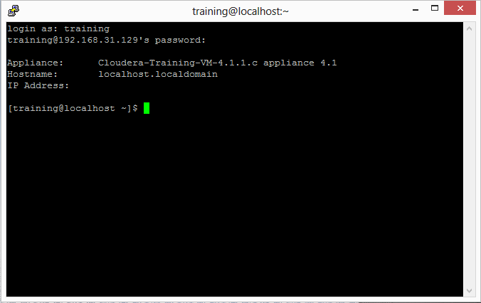
Cont.
Login training
Password training
After login following screen should appear

Slide 113
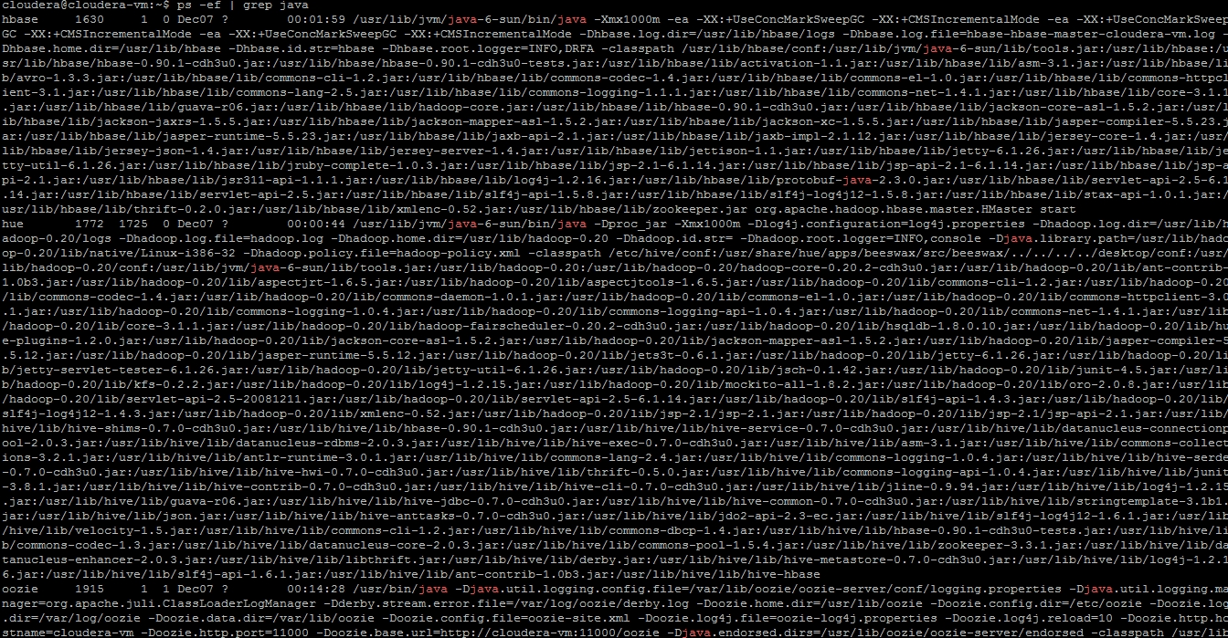
Cont.
To check if HADOOP processes are running in the system, type
ps –ef | grep java, name node, secondary name node, data node will be shown

Slide 114
Hadoop Installation from tar ball. ( Slides 47 – 66 )
Linux/Ubuntu environment
SSH installation
Java Installation
Hadoop installation and file configuration

Slide 115
SSH Installation

Slide 116
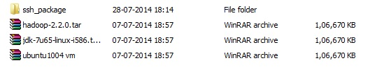
SSH Installation
Install Ubuntu 10.04 using vm player after extracting it from zip file.
Before logging in, choose keyboard as USA.
Username : user
Password : password
Copy “ssh_package” to your ubuntu desktop using pendrive.
(Note: you won’t be able to use WINscp before installing ssh)

Slide 117
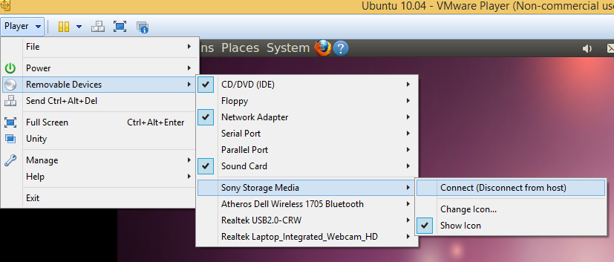
SSH Installation (Cont.)
Open a new terminal ( Cntrl + Alt + t ) and run following commands.
cd /home/user/Desktop/ssh_package
sudo dpkg -i openssh-client_1%3a5.3p1-3ubuntu7_i386.deb
sudo dpkg -i openssh-server_1%3a5.3p1-3ubuntu7_i386.deb
(Note : first install client , then install server )

Slide 118
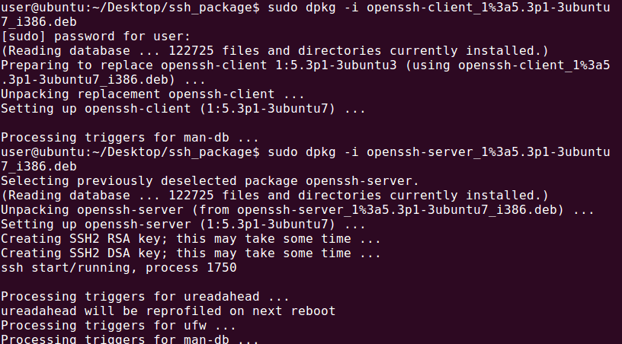
SSH Installation (Cont.)
Now connect with Winscp and transfer hadoop and java setup to your ubuntu environment.

Slide 119
Java Installation

Slide 120
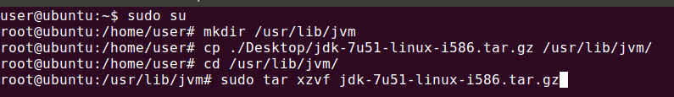
Java Installation
Download jdk for linux
http://www.oracle.com/technetwork/java/javase/downloads/jdk7-downloads-1880260.html
Create a directory in root mode and install jdk from tar file.

Slide 121
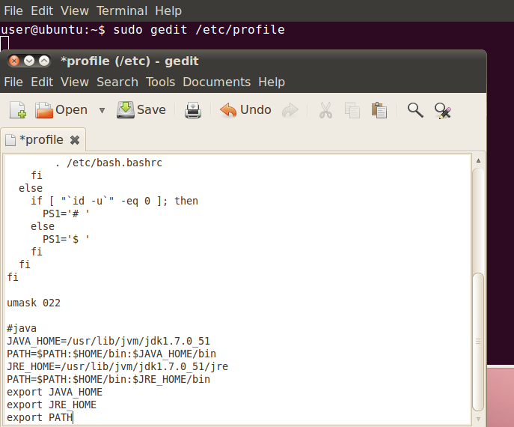
Java Installation (Cont.)
Restart your terminal and append append your /etc/profile

Slide 122
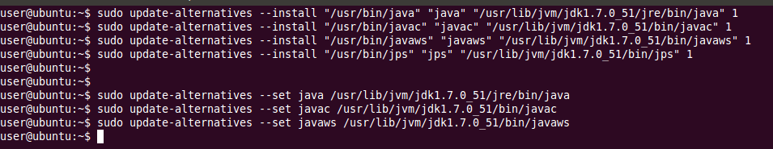
Java Installation (Cont.)
Run following commands
sudo update-alternatives --install "/usr/bin/java" "java“ "/usr/lib/jvm/jdk1.7.0_<java version>/jre/bin/java" 1
sudo update-alternatives --install "/usr/bin/javac" "javac“ "/usr/lib/jvm/jdk1.7.0_<java version>/bin/javac" 1
sudo update-alternatives --install "/usr/bin/javaws" "javaws“ "/usr/lib/jvm/jdk1.7.0_<java version>/bin/javaws" 1
sudo update-alternatives --install "/usr/bin/jps" "jps“ "/usr/lib/jvm/jdk1.7.0_<java version>/bin/jps" 1
sudo update-alternatives --set java /usr/lib/jvm/jdk1.7.0_<java version>/jre/bin/java
sudo update-alternatives --set javac /usr/lib/jvm/jdk1.7.0_<java version>/bin/javac
sudo update-alternatives --set javaws /usr/lib/jvm/jdk1.7.0_<java version>/bin/javaws

Slide 123
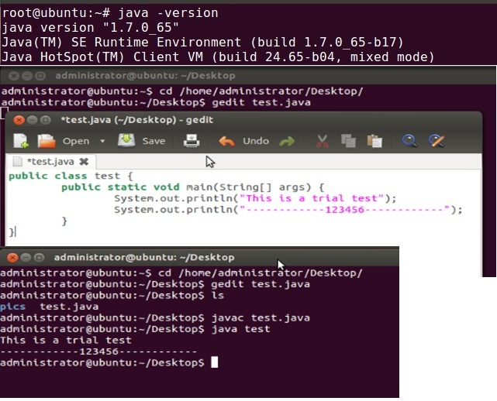
Java Installation (Cont.)
Start and new terminal and check java installation by running a program.

Slide 124
Hadoop Installation

Slide 125
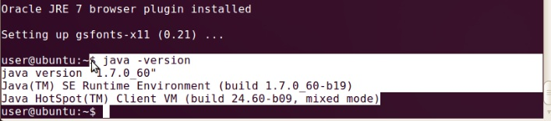
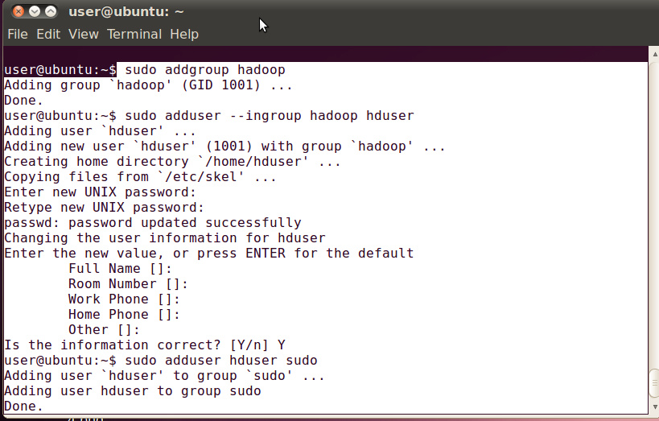
Hadoop Installation
After proper installation of Vmware and Ubuntu and setting up java …go a/c to the screenshots as given below.
Adding a new user for hadoop and relogin into it.

Slide 126

Hadoop Installation (Cont.)
After adding new user in group hadoop type the following commands for configuring ssh & taking ownership.

Slide 127

Hadoop Installation (Cont.)
Extract the hadoop 2.2.0 and copy it to a location.

Slide 128

Hadoop Installation (Cont.)
Changing ownership of hadoop folder
Ownership can be checked by typing “ ls -lrt “

Slide 129

Hadoop Installation (Cont.)
All the commands are provided in a text file for ease.After copying the hadoop tar file extract it according to the commands given.
Ownership can be checked by typing “ ls -lrt “

Slide 130
Changing hadoop configuration files
All the files are in /usr/local/hadoop/etc/hadoop/
In hadoop-env.sh add,
export JAVA_HOME=/usr/lib/jvm/jdk/<java version should be mentioned here>
In core-site.xml add following between configuration tabs,
<property>
<name>fs.default.name</name>
<value>hdfs://localhost:9000</value>
</property>
In yarn-site.xml add following between configuration tabs,
<property>
<name> yarn.nodemanager.aux-services</name>
<value>mapreduce_shuffle</value>
</property>
<property>
<name>yarn.nodemanager.aux-services.mapreduce.shuffle.class</name>
<value>org.apache.hadoop.mapred.ShuffleHandler</value>
</property>

Slide 131
Changing hadoop configuration files (Cont.)
In mapred-site.xml copy the mapred-site.xml.template and rename it to mapred-site.xml & add following between configuration tabs,
<property>
<name>mapreduce.framework.name</name>
<value>yarn</value>
</property>
In hdfs-site.xml add following between configuration tabs,
<property>
<name>dfs.replication</name>
<value>1</value>
</property>
<property>
<name>dfs.namenode.name.dir</name>
<value>file:/home/hduser/mydata/hdfs/namenode</value>
</property>
<property>
<name>dfs.datanode.data.dir</name>
<value>file:/home/hduser/mydata/hdfs/datanode</value>
</property>

Slide 132
Changing hadoop configuration files (Cont.)
Finally update your $HOME/.bahsrc
cd $HOME
vi .bashrc
Append following lines in the end and save and exit
#Hadoop variables
export JAVA_HOME=/usr/lib/jvm/jdk/<your java version>
export HADOOP_INSTALL=/usr/local/hadoop
export PATH=$PATH:$HADOOP_INSTALL/bin
export PATH=$PATH:$HADOOP_INSTALL/sbin
export HADOOP_MAPRED_HOME=$HADOOP_INSTALL
export HADOOP_COMMON_HOME=$HADOOP_INSTALL
export HADOOP_HDFS_HOME=$HADOOP_INSTALL
export YARN_HOME=$HADOOP_INSTALL

Slide 133

Changing hadoop configuration files (Cont.)
Checking hadoop version and making directories for name node and datanode.

Slide 134

Starting Hadoop
Format namenode and start all daemons,

Slide 135

Starting Hadoop (Cont.)
Restart all your hadoop-daemons and check daemons through “jps”.
Starting hadoop and yarn services .
start-dfs.sh

Slide 136

Starting yarn daemons
start-yarn.sh :- for starting yarn services.
NOTE:- to stop the daemons just omit start and write stop

Slide 137

Running MR program
Running put command
Running MR program

Slide 138


Accesing HTTP interface
Create a new bookmark
Viewing results of MR job

Slide 139

Accesing HTTP interface
Create a new bookmark

Slide 140
Pig installation

Slide 141


Installation
Pre Requisites:
Working Hadoop (HDFS and Mapreduce) environment
Pig tarball
Installation
Create a directory and untar the pig tarball
Give the ownership of that folder to “hadoop_user” user

Slide 142

Installation
Installation
Update the .bashrc file.
vi ~/.bashrc
export PIG_HOME=/usr/lib/pig/pig-0.11.1/
export PATH=$PATH:$PIG_HOME/bin

Slide 143


Checking
Checking
Upload a file from your local filesystem to your HDFS.
Load that file using PigStorage() and dump its contents on console

Slide 144

Closing Single node-cluster
Closing
First stop all the java processes using “stop-all.sh”.
Then logout from hadoop dedicated user by “exit”.
Note: Improper closing or exiting may corrupt the HDFS system. On restarting, it may open in safe mode and then unable to load all the data on data nodes. Thus you may need to reformat namenode causing all the data to get lost

Slide 145

Safemode
You may have to manually exit safe mode using following command
Hadoop dfsadmin –safemode leave
This may cause some datablocks to corrupt and cause loss of data on HDFS.

Slide 146
Configurations
Each component is configured using an XML file.
NOTE: In HADOOP version 2.2 all the confs are done in a single file hadoop-site.xml
In newer versions from 0.20 onwards this file is split into 3 files (Properties names are same only the files have been split)
core-site.xml -> Core properties go here
hdfs-site.xml -> HDFS Properties go here
mapred-site.xml -> Map reduce properties are configured here
Since we are using CDH4 it uses HADOOP version 2.0.0

Slide 147
Modes
Standalone mode-> No daemons run, everything runs in single process. Suitable for debugging MR programs
Pseudo Distributed -> All HADOOP processes run on local machine, simulating small cluster of 1 node
Fully Distributed -> HADOOP runs on a cluster of machines.

Slide 148
Properties
Component | Property | Standalone | Pseudo-distributed | Fully distributed
Core | fs.default.name | file:///(default) | hdfs://localhost/ | hdfs://namenode/
HDFS | dfs.replication | N/A | 1 | 3 (default)

Slide 149

mapred-site.xml
mapred-site.xml location /usr/local/hadoop/etc/hadoop/

Slide 150

hdfs-site.xml
hdfs-site.xml location /usr/local/hadoop/etc/hadoop/

Slide 151

core-site.xml
core-site.xml location /usr/local/hadoop/etc/hadoop/

Slide 152
VM Configurations
The VM provided is preconfigured with these properties, the properties can be verified by these files present in location /usr/lib/hadoop/conf

Slide 153
VM Configurations
After checking the configurations, to check the status and health of HDFS do
HADOOP fsck / -files –blocks
This command gives the blocks and metadata information of HDFS i.e., directory namespace information, size, block Id, permissions etc
If the setup is successful status will be shown HEALTHY

Slide 154

Status HDFS

Slide 155
HDFS Interfaces / Clients
HTTP Interfaces with browsers
Using CLI (Command line) utility
Programmatically using Java
Using thrift APIs with other languages like C
Most common use is with command line and Java APIs

Slide 156
HTTP Interfaces

Slide 157
HTTP APIs
HTTP: HDFS defines read only interface to browse directory listings and data over HTTP. HTTP web server runs on top of name node on port 50070, while file data is streamed from data nodes by their web servers running on 50075

Slide 158

NameNode GUI

Slide 159


Slide 160
Command Line Utilities

Slide 161
HADOOP Shell commands
http://hadoop.apache.org/docs/r0.18.3/hdfs_shell.html
Some list of common commands are as :-
-ls- for listing files in hdfs.
Syntax :-- hadoop fs –ls
-mkdir - for creating a directory in hdfs.
Syntax :-- hadoop fs –mkdir
-put – for copying file to hdfs from local file system
Syntax :-- hadoop fs –put <source file dest.> <destn.>

Slide 162
Command to List Files and DIRS
ls
Usage: HADOOP fs -ls <args>
For a file returns stat on the file with the following format: filename <number of replicas> filesize modification_date modification_time permissions userid groupid
For a directory it returns list of its direct children as in unix. A directory is listed as: dirname <dir> modification_time modification_time permissions userid groupid

Slide 163

Example ls

Slide 164
Practice Exercise
Use command ls and see the output from command line and then do HADOOP ls

Slide 165
HADOOP mkdir
mkdir – Takes path URI as argument and creates directory
Usage: hadoop fs -mkdir <paths>
Takes path uri's as argument and creates directories. The behavior is much like unix mkdir -p creating parent directories along the path
Exit Code:
Returns 0 on success and -1 on error

Slide 166

Example mkdir

Slide 167
Practice Exercise
Make a HADOOP directory using mkdir command with your name and then do ls for that directory
mkdir <yourName>

Slide 168
HADOOP put
Usage: hadoop fs -put <localsrc> ... <dst>
Copy single src, or multiple srcs from local file system to the destination filesystem. Also reads input from stdin and writes to destination filesystem.

Slide 169

Example Put

Slide 170
Practice Exercise
Write a file in your local file system of vm using vi editor, save that file. Now put that file in your named directory in HDFS using put command.
vi <myname>
HADOOP dfs –put <myname> <hadoop destination>

Slide 171
HADOOP Get
Get
Usage: hadoop fs -get [-ignorecrc] [-crc] <src> <localdst>
Copy files to the local file system. Files that fail the CRC check may be copied with the –ignorecrc option. Files and CRCs may be copied using the -crc option.

Slide 172

Example Get

Slide 173
Practice Exercise
Get the file you saved in HDFS to your local file system of VM, and read their contents and check if files are same.

Slide 174
HADOOP Copy to Local
Usage: hadoop fs -copyToLocal [-ignorecrc] [-crc] URI <localdst>
Similar to get command, except that the destination is restricted to a local file reference.

Slide 175

HADOOP Copy to Local

Slide 176
Java APIs

Slide 177
Java API’s
HDFS can be accessed with JAVA API’s as well
You can add/delete/view file system from them

Slide 178
Environment
To access hadoop API’s hadoop jars should be there in build path of eclipse
From /usr/lib/hadoop/client-0.20
copy this complete folder to your local system and add these jars into your build path

Slide 179

WinSCP
Use WINSCP to copy the Jars to local system

Slide 180

/usr/lib/hadoop/client-0.20

Slide 181
Project Settings
Make a new project in eclipse
Add these jars in it’s build path

Slide 182
Exercise
We will put a file in HDFS and try to read it’s contents with JAVA APIs

Slide 183


Slide 184
VM Environment
The default configurations in vm are local host. With this configuration HADOOP doesn’t allow external client connections.
To ease the testing and our understanding we would like to connect the HADOOP from our local OS where eclipse is installed, so that we don’t have to scp our jars or classes to vm.

Slide 185
Configurations Needed
Change the NAMENODE/JOBTRACKER from local host to the IP of vm
Files to be changed in /usr/lib/hadoop-0.20-mapreduce/conf are mapred-site.xml, hdfs-site.xml, core-site.xml

Slide 186

Editing Read Only File

Slide 187


To edit the file you will have to do sudo su so that with root access you can change the file
You can now edit the file and change the localhost to IP of vm

Slide 188
Changes to be Done in Local OS
If you are running MR jobs/HDFS access from outside vm, host name entry needs to be done in the local OS as well, so that IP corresponding to the name can be pinged
In running from windows C:\Windows\System32\drivers\etc\hosts, add the mapping 192.168.31.128 cloudera-vm

Slide 189


Slide 190
Changes to be Done
Change the fs.default.name to hdfs://<IP OF VM>:8020 in /etc/hadoop-0.20/conf/core-site.xml
In mapred-site.xml mapred.job.tracker to <IP OF VM>:8021
In /etc/hosts make sure that there is no entry of 127.0.0.1 and there is a hostname for your VM IP

Slide 191


Slide 192
Restart HADOOP Services
To make your changes effective in hadoop you will have to restart namenode, data node and jobtracker
Use commands
sudo service hadoop-hdfs-namenode restart
sudo service hadoop-hdfs-datanode restart
sudo service hadoop-0.20-mapreduce-jobtracker restart
sudo service hadoop-0.20-mapreduce-tasktracker restart

Slide 193


Restart Name Node and Data Node

Slide 194
Health Check
After doing all the changes check if HDFS is accessible
HADOOP dfs –ls /

Slide 195

Troubleshooting Guide
You can always check logs of namenode, datanode to see if any errors have occurred while starting namenode/datanode or hadoop services in /var/log/hadoop-0.20-mapreduce/logs and /usr/lib/hadoop-hdfs/logs
In case you get the error

Slide 196
Issue must be with your host mapping, please check /etc/hosts to see if there is any entry for localhost IP 127.0.0.1. If it is there comment or delete that and restart your hdfs services

Slide 197
Distscp
Tool for large inter/intra cluster copying.
Can be used to copy large data from one hdfs cluster to another. Provided both are running on same HADOOP version
HADOOP distscp hdfs://namenode1/foo hdfs://namenode2/foo2
This will copy /foo directory in foo2
This is implemented as MR job.(Will be covered in MR section)

Slide 198
Java APIs

Slide 199
APIs
http://hadoop.apache.org/docs/current/api/org/apache/hadoop/fs/Path
Path (URI aUri)
Construct a path from a URI. This URI is the path of HDFS
The file system can be obtained by:
http://hadoop.apache.org/docs/current/api/org/apache/hadoop/fs/FileSystem.html

Slide 200

APIs

Slide 201

Output

Slide 202

Verify with HDFS CONENTS

Slide 203
Seek
Read from offset

Slide 204
Java API
http://hadoop.apache.org/docs/current/api/org/apache/hadoop/fs/FSDataInputStream.html

Slide 205


Slide 206


Slide 207

Copy File

Slide 208


Slide 209
Case Study Exercise
STORAGE: Put the provided sample logs of airmobile in HDFS directory with name airmobile with java APIs.
READ: Try to read the file using FS commands.
The fields in the given file represent field following msidn= “<subscriber Id>”, databytes =“Bytes Downloaded“, city=“<city”>, sitevisited=“<Site Visited”>. For analysis write a Java program to find out subscribers and their corresponding downloaded bytes.

Slide 210
Next Agenda
Next we will try to find out how the same Java program implemented in last exercise can be done with Map Reduce.

